Slide 1
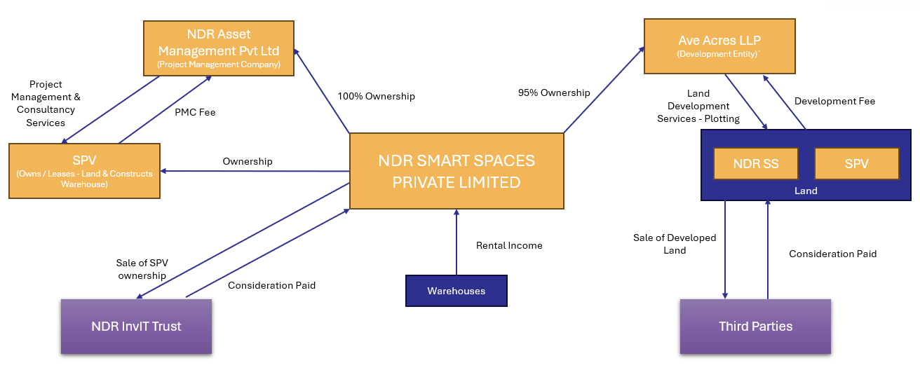
Overview
NDR SMART - STRUCTURE

Slide 2
Structure
NDR Asset Management Pvt Ltd
(Project Management Company)
Ave Acres LLP
(Development Entity)`
Project Management & Consultancy Services
95% Ownership
Land Development Services - Plotting
100% Ownership
Development Fee
PMC Fee
NDR SMART SPACES PRIVATE LIMITED
Land
SPV
(Owns / Leases - Land & Constructs Warehouse)
Ownership
NDR SS
SPV
Rental Income
Sale of Developed Land
Sale of SPV ownership
Consideration Paid
Consideration Paid
Warehouses
NDR InvIT Trust
Third Parties

Slide 3
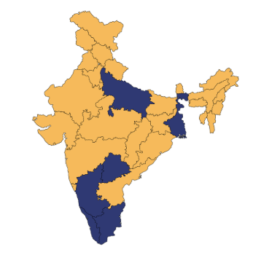
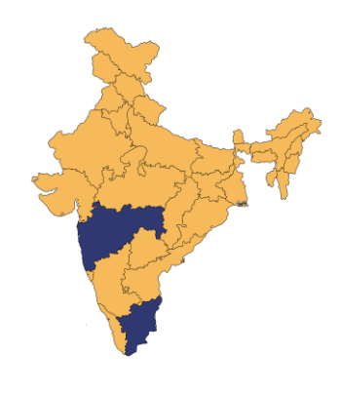
Growth Roadmap
WAREHOUSING LOCATIONS
PLOTTING LOCATIONS
South Zone: Chennai – Nallur, Krishnapuram Kandigai, Oragadam, Walajapet Bangalore – Bidadi Hosur Kochi West Zone: Hyderabad, Pune | East Zone: Kolkata Varanasi Lucknow Kanpur North Zone: Ghaziabad
Tamil Nadu: Coimbatore – 15 Acres Chettipalayam – 6 Acres Echankarnai – 6 Acres | Mumbai: Aavsome – 40 Acres

